Slide 1


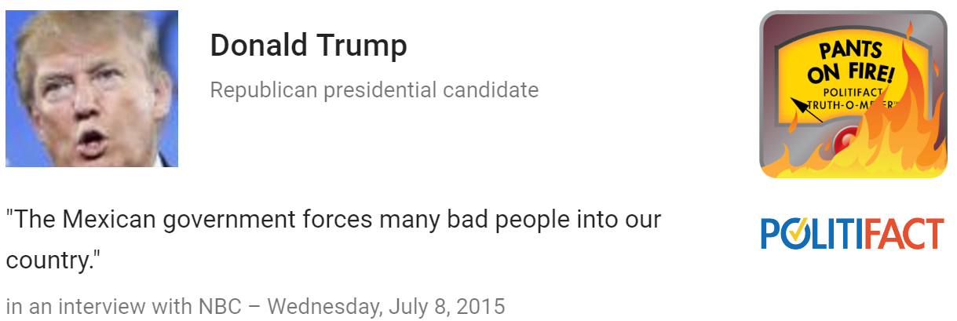
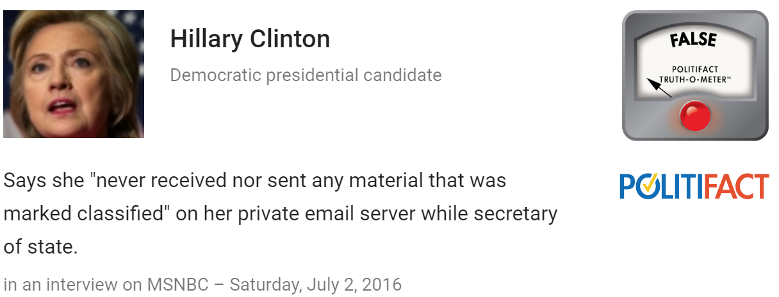

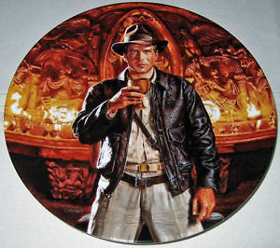
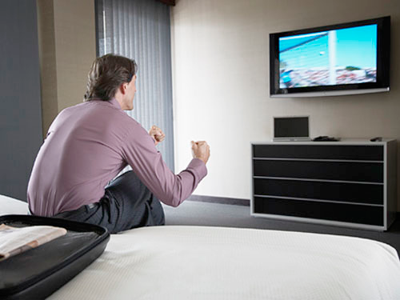
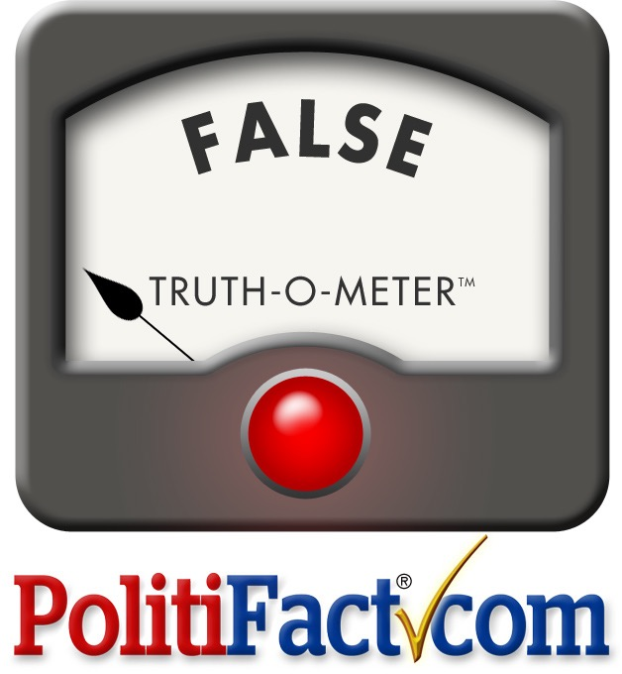





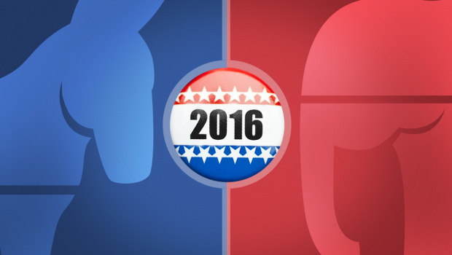
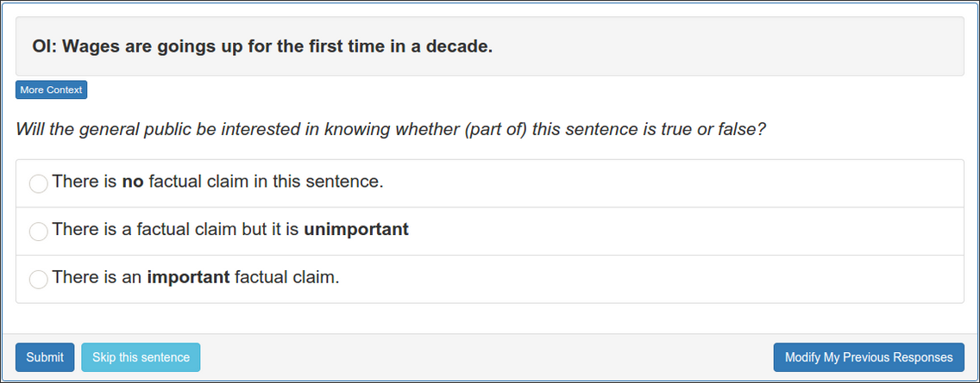
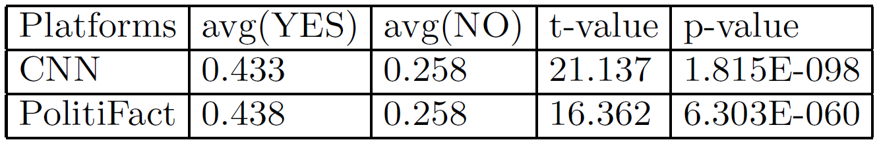
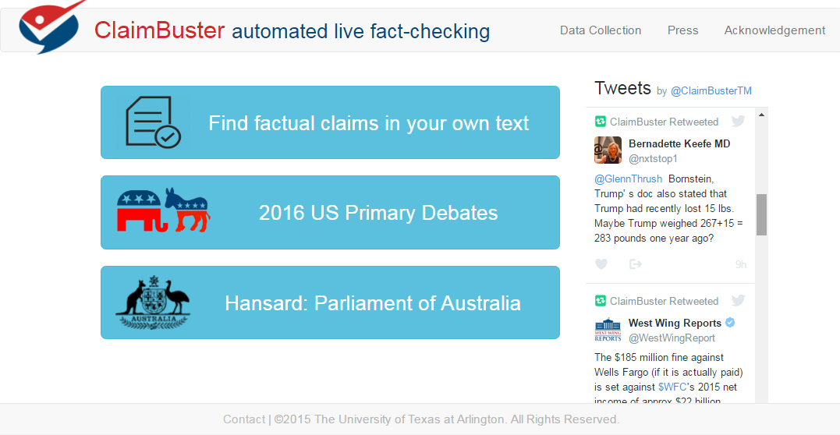
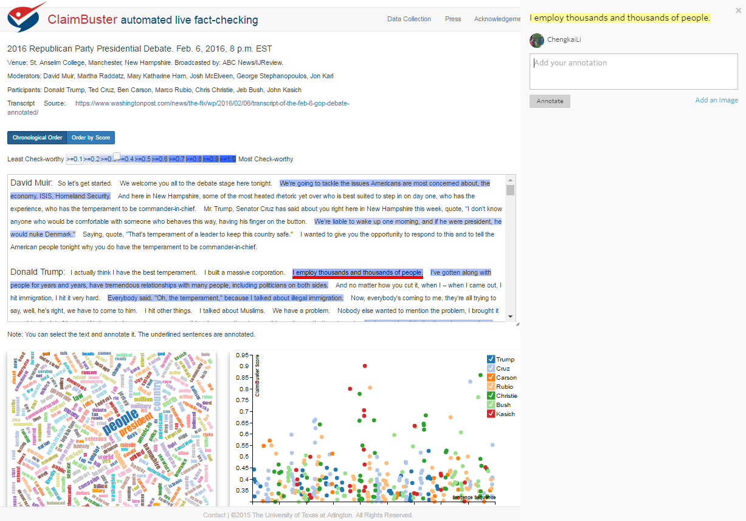













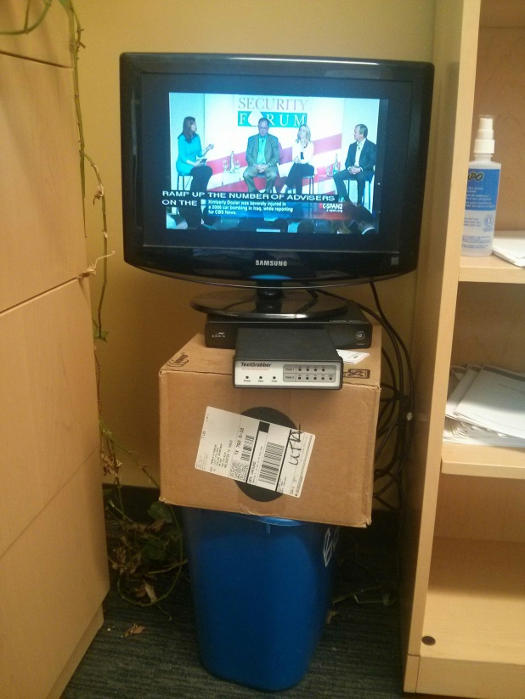



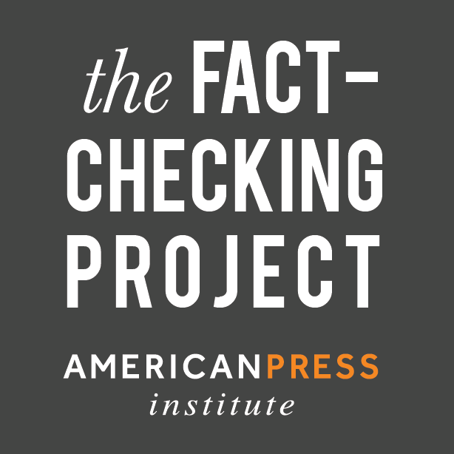





ClaimBuster: Automated, Live Fact-checking
The Innovative Database and Information Systems Research Laboratory (IDIR)
Department of Computer Science, Department of Communication, University of Texas at Arlington
In Collaboration with Duke University, Google Research and Stanford University
The Quest to Automate Fact-checking
People make factual claims all the time
Fact-checking is challenging
Limited resources, time-consuming tasks
96 active fact-checking sites in 2016 (PolitiFact .com, CNN, Washington Post, …)
Several hundred professional fact-checkers
One fact-check oftentimes takes one day
vs.
Fast-spreading falsehoods and half-truths on the web and social network
ClaimBuster goals
debates
interviews
speeches
political ads
social media
web
news
claimed detected and ranked by check-worthiness
The “Holy Grail”
matched existing fact-checks: delivered via browser extensions, mobile and smart-TV apps
repository of fact-checks by professionals
new factual claims:
solicit analyses from professionals; algorithmic fact-checking
Source: Bill Adair
Detecting Check-worthy Factual Claims
presidential debate transcripts (1960-2012)
ground truth
feature vectors
factual claims recommended for checking
Ground truth collection
human annotation
Feature extraction
learning algorithm
Hundreds of participants; 1000 screening sentences to detect low-quality participants and spammers.
Classification
2016 presidential debates
Non-Factual Sentence (NFS) (Opinions, beliefs, declarations): But I think it’s time to talk about the future.
Unimportant Factual Sentence (UFS): Two days ago we ate lunch at a restaurant.
Check-worthy Factual Sentence (CFS): He voted against the first Gulf War.
Feature extraction & selection
Real-time test during primary debates
Sentiment: 0.032
Words: state, legislature, 87, percent, democrat
Scores given by ClaimBuster to sentences fact-checked by professionals are significantly higher than scores to those not chosen for checking.
I was in a state where my legislature was 87 percent Democrat.
Part-of-Speech: Noun
Entity Type: Quantity
Concept: United States
Prototype and Development Status
Monitoring political discourses and social media
Live coverage of debates
Prototype
idir.uta.edu/claimbuster
Ground truth collection
bit.ly/claimbusters
Funding
Closed-captions devices
Media coverage

